Slide 1
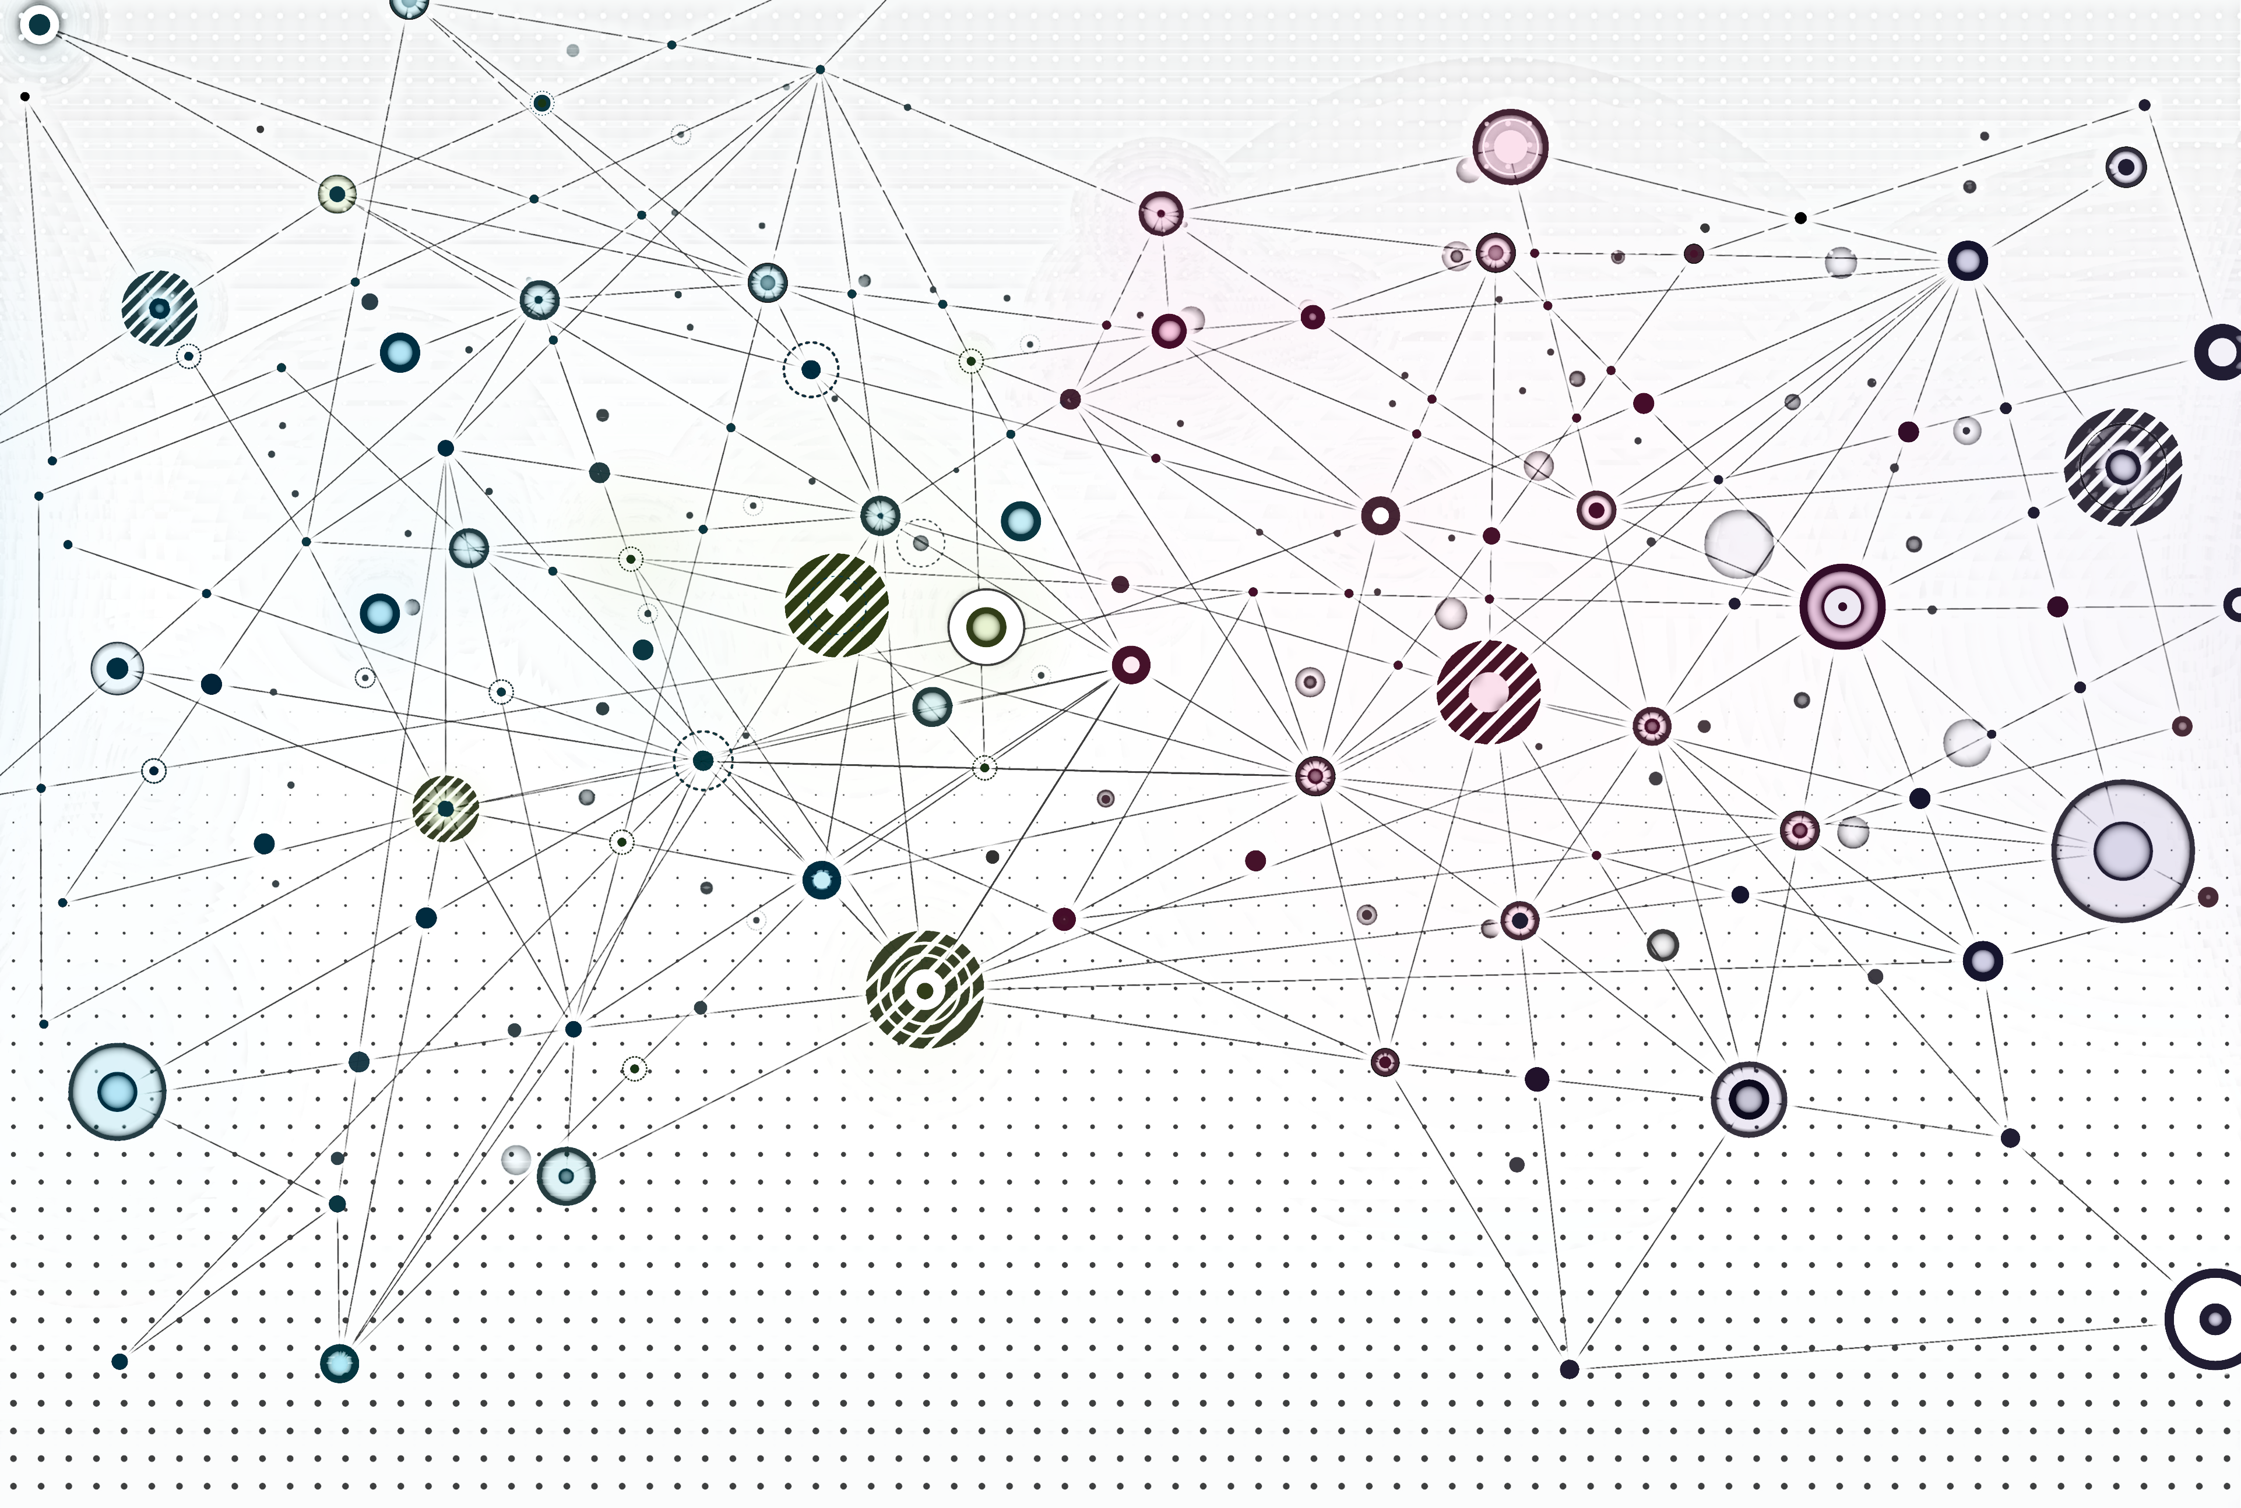
GNNs in practice

Slide 2
Overview
Recap
GNN prediction heads
GNN training
GNN performance evaluation
Splitting our dataset

Slide 3
Recap

Slide 4
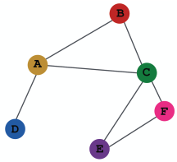
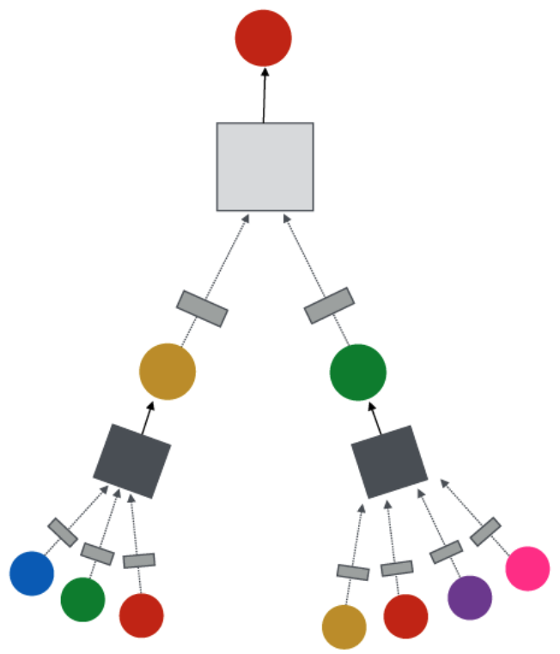
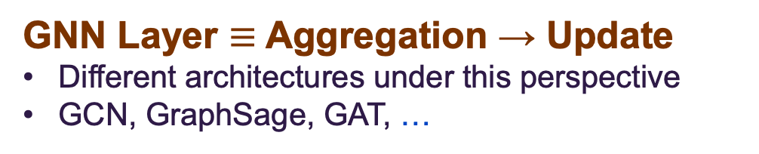
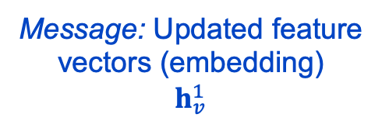
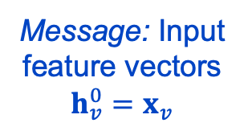
Message passing in GNNs
GNN Layer $≡$ Aggregation → Update
Different architectures under this perspective
GCN, GraphSage, GAT, …
Target node
GNN Layer 2
Input graph
Message: Updated feature vectors (embedding)
$$h_{v}^{1}$$
Layer Operations
Neighborhood message aggregation
Node message (embedding) update
GNN Layer 1
Message: Input feature vectors
$$h_{v}^{0}=x_{v}$$
Image credit: Jure Leskovec, http://cs224w.stanford.edu

Slide 5
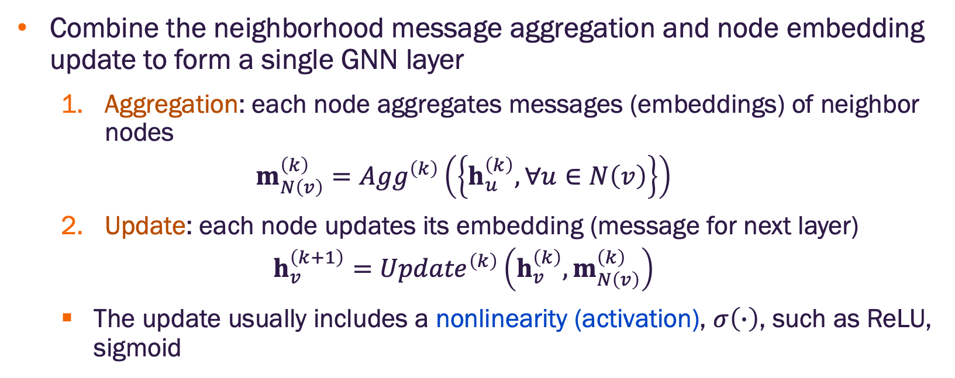
Message aggregation and update as a GNN layer
Combine the neighborhood message aggregation and node embedding update to form a single GNN layer
Aggregation: each node aggregates messages (embeddings) of neighbor nodes
$$m_{N\left(v\right)}^{\left(k\right)}={Agg}^{\left(k\right)}\left(\left\{h_{u}^{\left(k\right)}, ∀u∈N\left(v\right)\right\}\right)$$
Update: each node updates its embedding (message for next layer)
$$h_{v}^{\left(k+1\right)}={Update}^{\left(k\right)}\left({h_{v}^{\left(k\right)},m}_{N\left(v\right)}^{\left(k\right)}\right)$$
The update usually includes a nonlinearity (activation), $σ\left(∙\right)$, such as ReLU, sigmoid

Slide 6
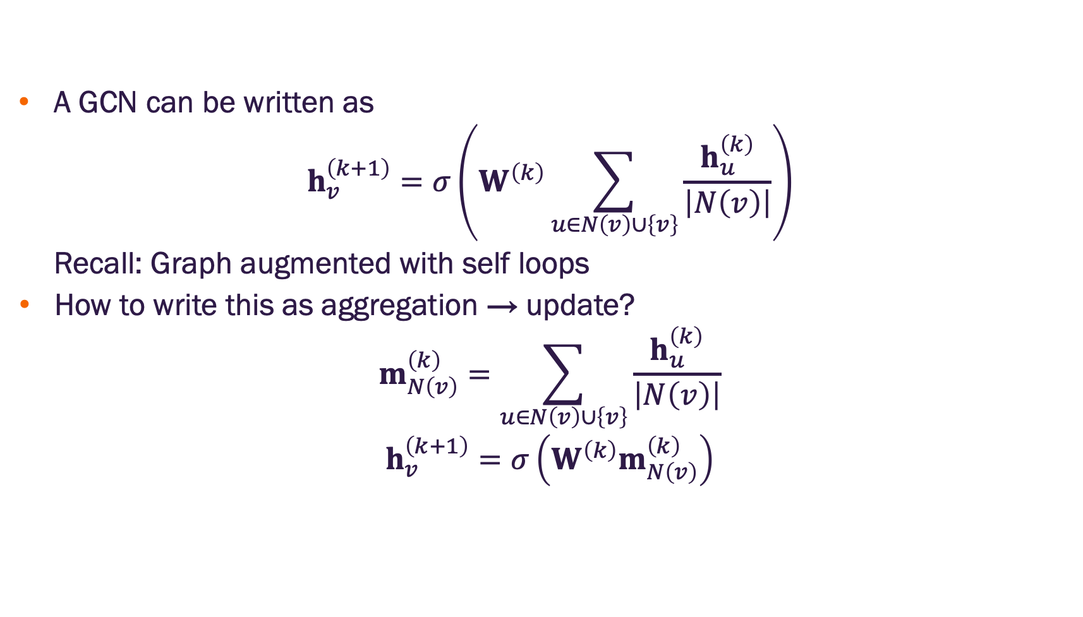
Graph convolutional networks
A GCN can be written as
$$h_{v}^{\left(k+1\right)}=σ\left(W^{\left(k\right)}\sum_{u∈N\left(v\right)∪\left\{v\right\}}{\frac{h_{u}^{\left(k\right)}}{\left|N\left(v\right)\right|}}\right)$$
Recall: Graph augmented with self loops
How to write this as aggregation → update?
$$m_{N\left(v\right)}^{\left(k\right)}=\sum_{u∈N\left(v\right)∪\left\{v\right\}}{\frac{h_{u}^{\left(k\right)}}{\left|N\left(v\right)\right|}}$$
$$h_{v}^{\left(k+1\right)}=σ\left(W^{\left(k\right)}m_{N\left(v\right)}^{\left(k\right)}\right)$$

Slide 7
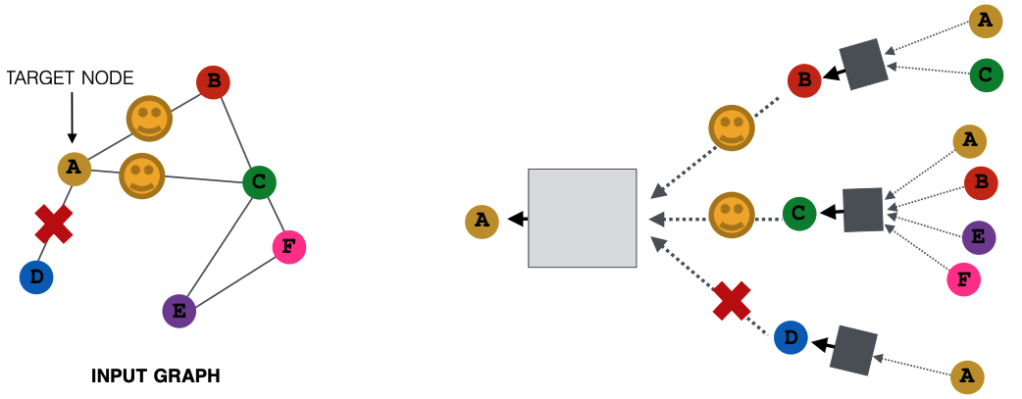
GraphSAGE (SAmple and aggreGatE) sampling
In expectation (on average), we get embeddings similar to aggregating over all neighbors
Greatly reduces computational cost
Image credit: Jure Leskovec, http://cs224w.stanford.edu

Slide 8
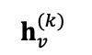
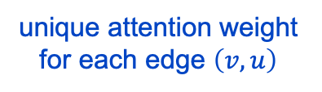
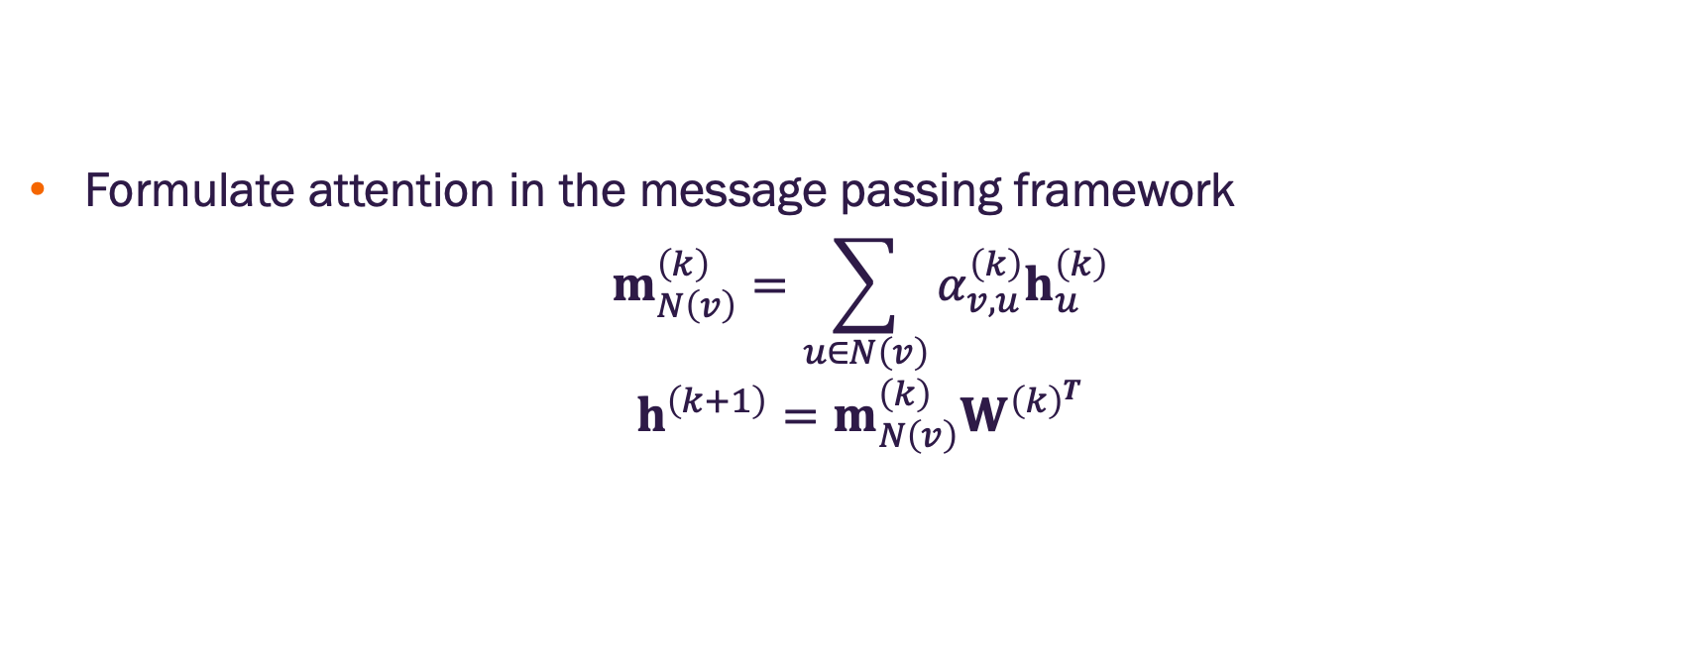
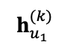
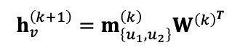

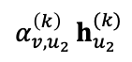

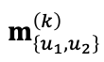
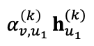

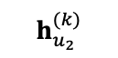

Graph attention with convolution update
Formulate attention in the message passing framework
$$m_{N\left(v\right)}^{\left(k\right)}=\sum_{u∈N\left(v\right)}{α_{v,u}^{\left(k\right)}h_{u}^{\left(k\right)}}$$
$$h^{\left(k+1\right)}=m_{N\left(v\right)}^{\left(k\right)}W^{{\left(k\right)}^{T}}$$
Message
Aggregation w/ Attention
attention weighting
$$h_{u_{1}}^{(k)}$$
summation
$$h_{v}^{(k)}$$
$$u_{1}$$
$${α_{v,u_{1} }^{\left(k\right)}h}_{u_{1}}^{(k)}$$
Update
$$v$$
target node
$$m_{\left\{u_{1},u_{2}\right\}}^{\left(k\right)}$$
$$h_{v}^{\left(k+1\right)}=m_{\left\{u_{1},u_{2}\right\}}^{\left(k\right)}W^{{\left(k\right)}^{T}}$$
$${α_{v,u_{2} }^{\left(k\right)}h}_{u_{2}}^{(k)}$$
$$u_{2}$$
$$h_{u_{2}}^{(k)}$$
same $W^{\left(k\right)}$ used in the attention weight computations
unique attention weight for each edge $\left(v,u\right)$

Slide 9
Graph attention with convolution update
Formulate attention in the message passing framework
$$m_{N\left(v\right)}^{\left(k\right)}=\sum_{u∈N\left(v\right)}{α_{v,u}^{\left(k\right)}h_{u}^{\left(k\right)}}$$
$$h^{\left(k+1\right)}=m_{N\left(v\right)}^{\left(k\right)}W^{{\left(k\right)}^{T}}$$
Message
Aggregation w/ Attention
attention weighting
$$h_{u_{1}}^{(k)}$$
summation
$$h_{v}^{(k)}$$
$$u_{1}$$
$${α_{v,u_{1} }^{\left(k\right)}h}_{u_{1}}^{(k)}$$
Update
$$v$$
target node
$$m_{\left\{u_{1},u_{2}\right\}}^{\left(k\right)}$$
$$h_{v}^{\left(k+1\right)}=m_{\left\{u_{1},u_{2}\right\}}^{\left(k\right)}W^{{\left(k\right)}^{T}}$$
$${α_{v,u_{2} }^{\left(k\right)}h}_{u_{2}}^{(k)}$$
$$u_{2}$$
$$h_{u_{2}}^{(k)}$$
same $W^{\left(k\right)}$ used in the attention weight computations
unique attention weight for each edge $\left(v,u\right)$

Slide 10
Why manipulate graphs
We’ve assumed that the network graph = the GNN structure
We might want to break this assumption if:
The input graph lacks features → apply feature augmentation (later lecture)
The graph is too sparse → add virtual nodes
The graph is too dense → apply GraphSAGE or other neighbor sampling
The graph is too large → sample subgraphs to compute embeddings (later lecture, time permitting)

Slide 11
GNN prediction heads

Slide 12
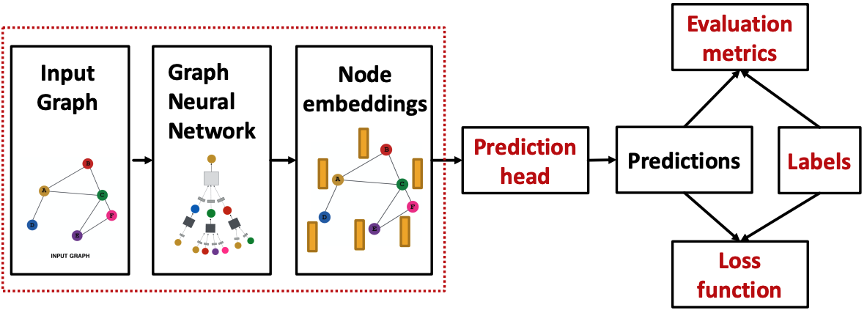

We’ve learned about these
GNN output: a set of node embeddings
$$\left\{h_{v}^{\left(K\right)} ∀v∈V\right\}$$
What do we do with these?
Image credit: Jure Leskovec, http://cs224w.stanford.edu

Slide 13
Add “prediction heads” (additional network layers) for:
node-level tasks
edge-level tasks
graph-level tasks
Image credit: Jure Leskovec, http://cs224w.stanford.edu

Slide 14
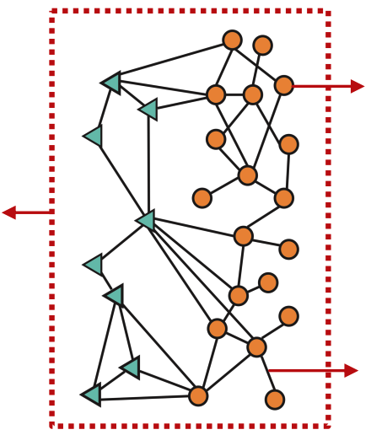
GNN prediction heads
Different tasks levels require different types of prediction heads
Node-level prediction
Graph-level prediction
Edge-level prediction
Image credit: Jure Leskovec, http://cs224w.stanford.edu

Slide 15
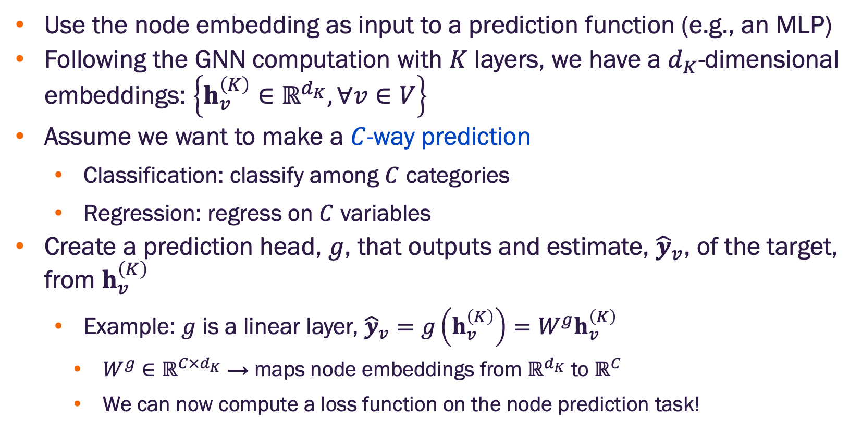
Node-level prediction head
Use the node embedding as input to a prediction function (e.g., an MLP)
Following the GNN computation with $K$ layers, we have a $d_{K}$-dimensional embeddings: $\left\{h_{v}^{\left(K\right)}∈ℝ^{d_{K}}, ∀v∈V\right\}$
Assume we want to make a $C$-way prediction
Classification: classify among $C$ categories
Regression: regress on $C$ variables
Create a prediction head, $g$, that outputs and estimate, ${\hat{y}}_{v}$, of the target, from $h_{v}^{\left(K\right)}$
Example: $g$ is a linear layer, ${\hat{y}}_{v}=g\left(h_{v}^{\left(K\right)}\right)=W^{g}h_{v}^{\left(K\right)}$
$W^{g}∈ℝ^{C×d_{K}}$ → maps node embeddings from $ℝ^{d_{K}}$ to $ℝ^{C}$
We can now compute a loss function on the node prediction task!

Slide 16
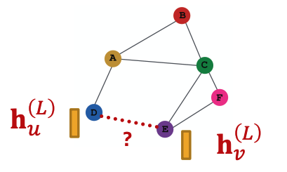
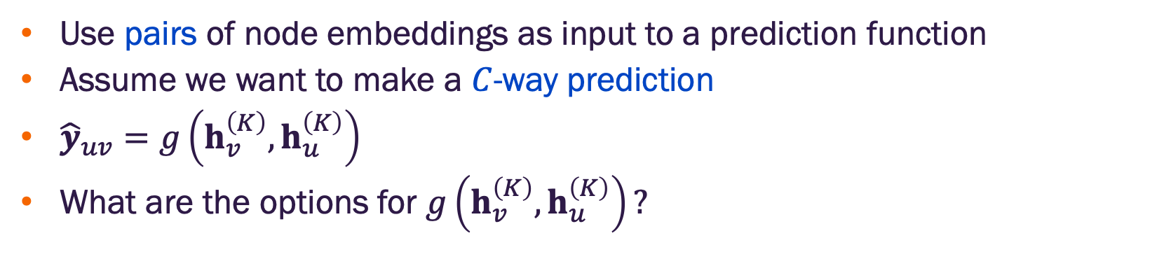
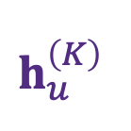
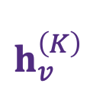
Edge-level prediction head
Use pairs of node embeddings as input to a prediction function
Assume we want to make a $C$-way prediction
${\hat{y}}_{uv}=g\left(h_{v}^{\left(K\right)},h_{u}^{\left(K\right)}\right)$
What are the options for $g\left(h_{v}^{\left(K\right)},h_{u}^{\left(K\right)}\right)?$
$$h_{v}^{\left(K\right)}$$
$$h_{u}^{\left(K\right)}$$
Image credit: Jure Leskovec, http://cs224w.stanford.edu

Slide 17
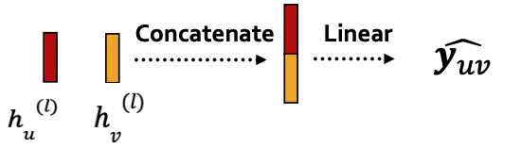
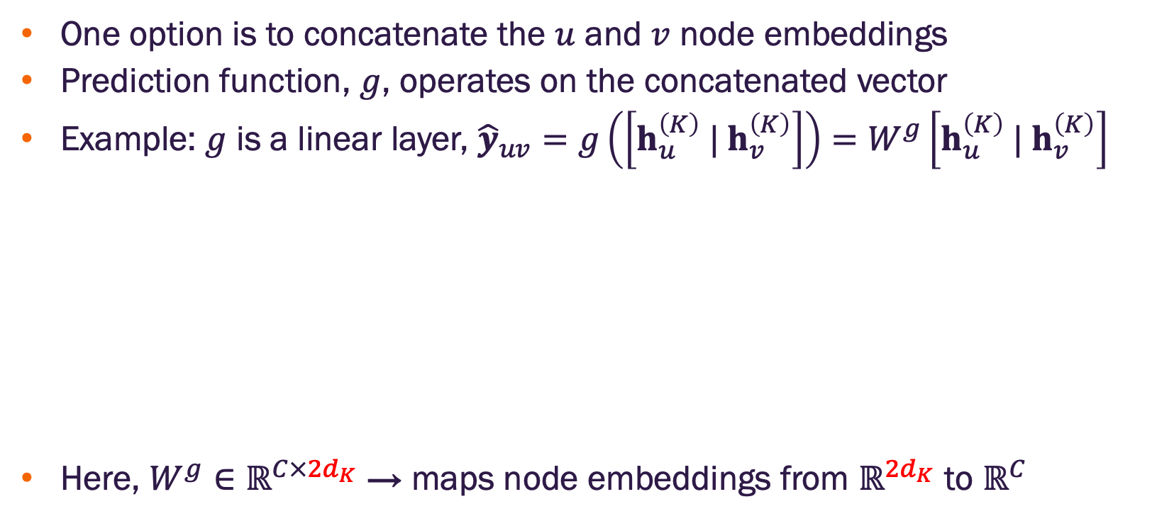

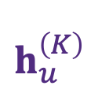
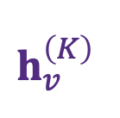
Edge-level prediction head with concatenation
One option is to concatenate the $u$ and $v$ node embeddings
Prediction function, $g$, operates on the concatenated vector
Example: $g$ is a linear layer, ${\hat{y}}_{uv}=g\left(\left[h_{u}^{\left(K\right)} |{ h}_{v}^{\left(K\right)}\right]\right)=W^{g}\left[h_{u}^{\left(K\right)} |{ h}_{v}^{\left(K\right)}\right]$
Here, $W^{g}∈ℝ^{C×{2d}_{K}}$ → maps node embeddings from $ℝ^{{2d}_{K}}$ to $ℝ^{C}$
$${\hat{y}}_{uv}$$
$$h_{v}^{\left(K\right)}$$
$$h_{u}^{\left(K\right)}$$
Account for the concatenation of embeddings
Image credit: Jure Leskovec, http://cs224w.stanford.edu

Slide 18
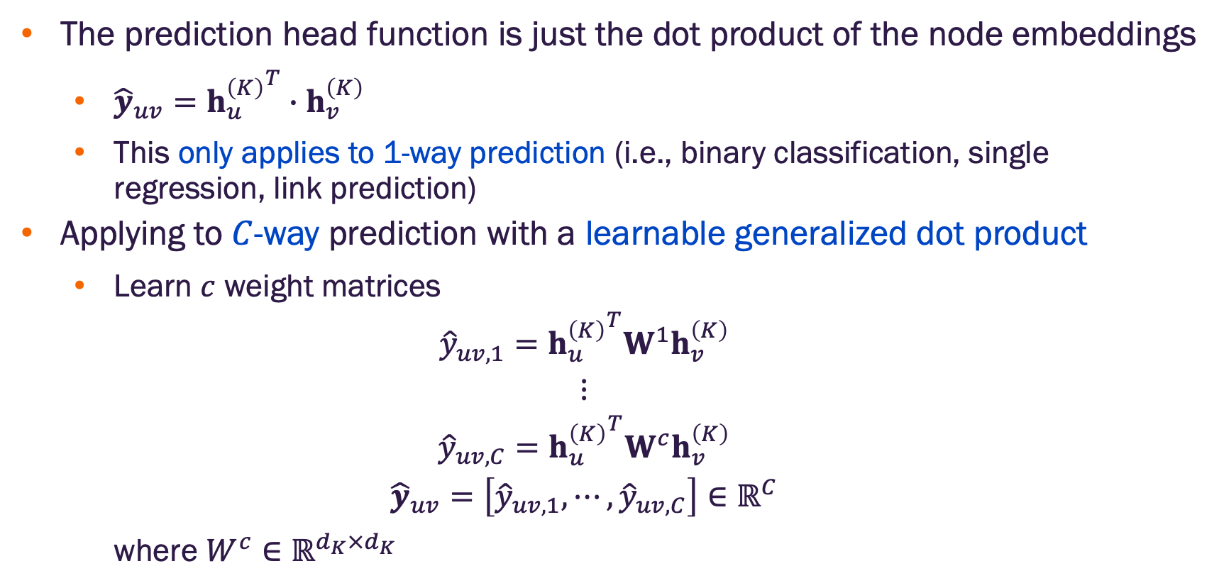
Edge-level prediction head with dot product
The prediction head function is just the dot product of the node embeddings
${\hat{y}}_{uv}={h_{u}^{\left(K\right)}}^{T}∙h_{v}^{\left(K\right)}$
This only applies to 1-way prediction (i.e., binary classification, single regression, link prediction)
Applying to $C$-way prediction with a learnable generalized dot product
Learn $c$ weight matrices
$${\hat{y}}_{uv,1}={h_{u}^{\left(K\right)}}^{T}W^{1}h_{v}^{\left(K\right)}$$
$$⋮$$
$${\hat{y}}_{uv,C}={h_{u}^{\left(K\right)}}^{T}W^{c}h_{v}^{\left(K\right)}$$
$${\hat{y}}_{uv}=\left[{\hat{y}}_{uv,1},⋯,{\hat{y}}_{uv,C}\right]∈ℝ^{C}$$
where $W^{c}∈ℝ^{d_{K}×d_{K}}$

Slide 19
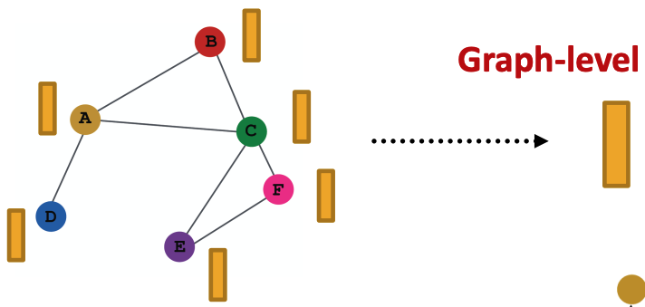
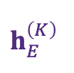
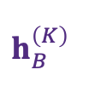
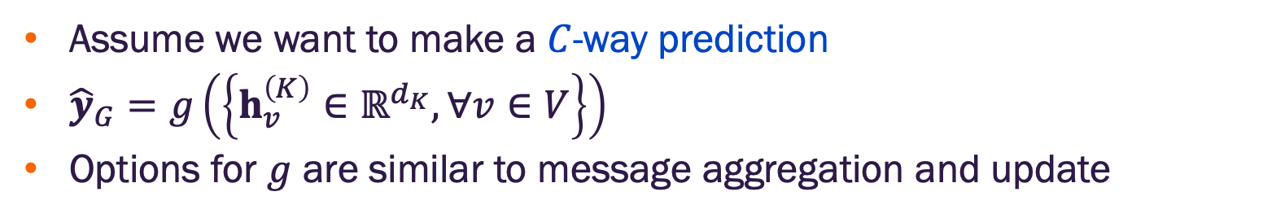
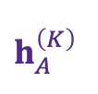
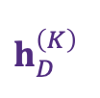
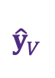
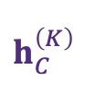
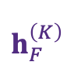
Graph-level prediction head
Assume we want to make a $C$-way prediction
${\hat{y}}_{G}=g\left(\left\{h_{v}^{\left(K\right)}∈ℝ^{d_{K}}, ∀v∈V\right\}\right)$
Options for $g$ are similar to message aggregation and update
$$h_{B}^{\left(K\right)}$$
$$h_{A}^{\left(K\right)}$$
$$h_{C}^{\left(K\right)}$$
$${\hat{y}}_{V}$$
$$h_{F}^{\left(K\right)}$$
$$h_{D}^{\left(K\right)}$$
$$h_{E}^{\left(K\right)}$$
Image credit: Jure Leskovec, http://cs224w.stanford.edu

Slide 20
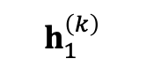
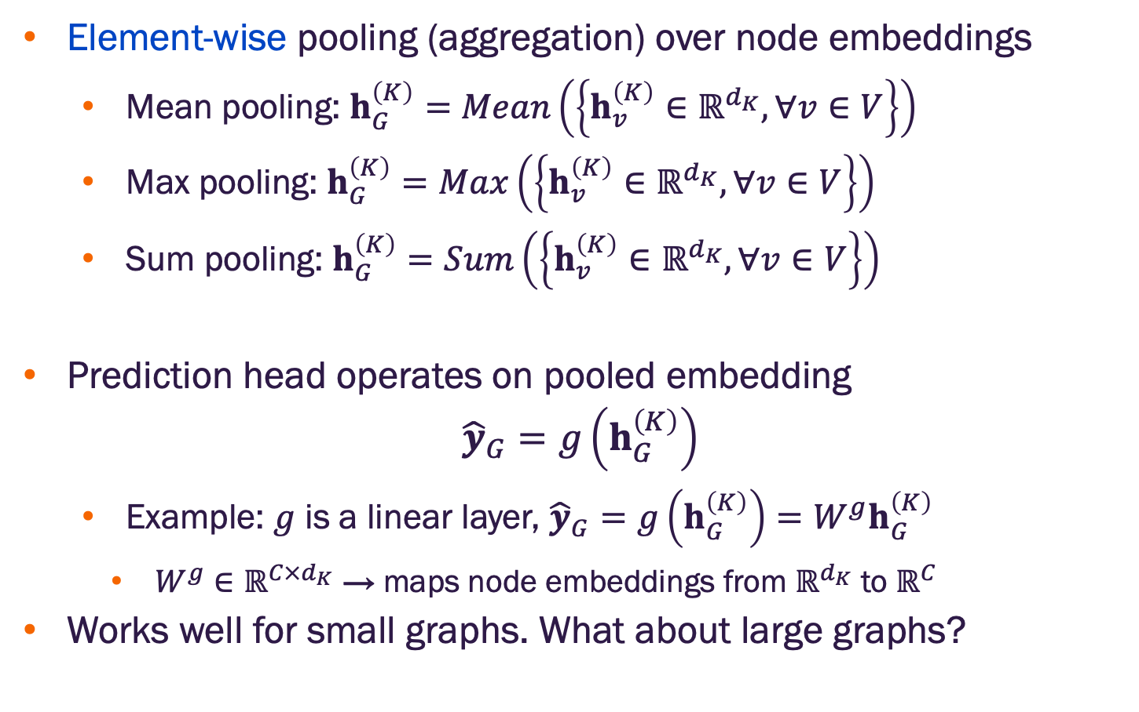
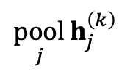
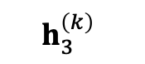
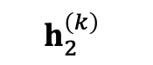
Graph-level prediction head via pooling
Element-wise pooling (aggregation) over node embeddings
Mean pooling: $h_{G}^{\left(K\right)}=Mean\left(\left\{h_{v}^{\left(K\right)}∈ℝ^{d_{K}}, ∀v∈V\right\}\right)$
Max pooling: $h_{G}^{\left(K\right)}=Max\left(\left\{h_{v}^{\left(K\right)}∈ℝ^{d_{K}}, ∀v∈V\right\}\right)$
Sum pooling: $h_{G}^{\left(K\right)}=Sum\left(\left\{h_{v}^{\left(K\right)}∈ℝ^{d_{K}}, ∀v∈V\right\}\right)$
Prediction head operates on pooled embedding
$${\hat{y}}_{G}=g\left(h_{G}^{\left(K\right)}\right)$$
Example: $g$ is a linear layer, ${\hat{y}}_{G}=g\left(h_{G}^{\left(K\right)}\right)=W^{g}h_{G}^{\left(K\right)}$
$W^{g}∈ℝ^{C×d_{K}}$ → maps node embeddings from $ℝ^{d_{K}}$ to $ℝ^{C}$
Works well for small graphs. What about large graphs?
$$h_{1}^{\left(k\right)}$$
$$h_{2}^{\left(k\right)}$$
$$h_{3}^{\left(k\right)}$$
$$\underset{j}{pool}{h_{j}^{\left(k\right)}}$$
element-wise pooling

Slide 21
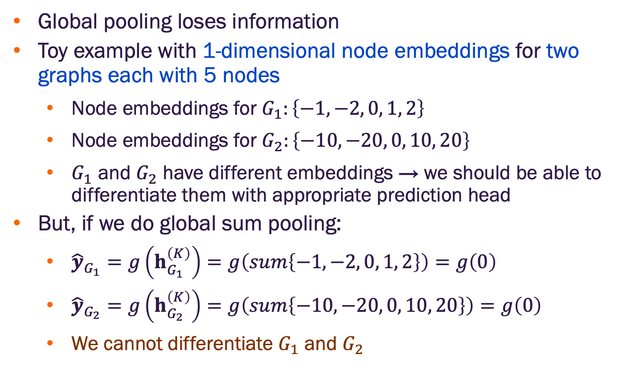
Limitations for global pooling
Global pooling loses information
Toy example with 1-dimensional node embeddings for two graphs each with 5 nodes
Node embeddings for $G_{1}:\left\{−1, −2, 0, 1, 2\right\}$
Node embeddings for $G_{2}:\left\{−10, −20, 0, 10, 20\right\}$
$G_{1}$ and $G_{2}$ have different embeddings → we should be able to differentiate them with appropriate prediction head
But, if we do global sum pooling:
${\hat{y}}_{G_{1}}=g\left(h_{G_{1}}^{\left(K\right)}\right)=g\left(sum\left\{−1, −2, 0, 1, 2\right\}\right)=g\left(0\right)$
${\hat{y}}_{G_{2}}=g\left(h_{G_{2}}^{\left(K\right)}\right)=g\left(sum\left\{−10, −20, 0, 10, 20\right\}\right)=g\left(0\right)$
We cannot differentiate $G_{1}$ and $G_{2}$

Slide 22
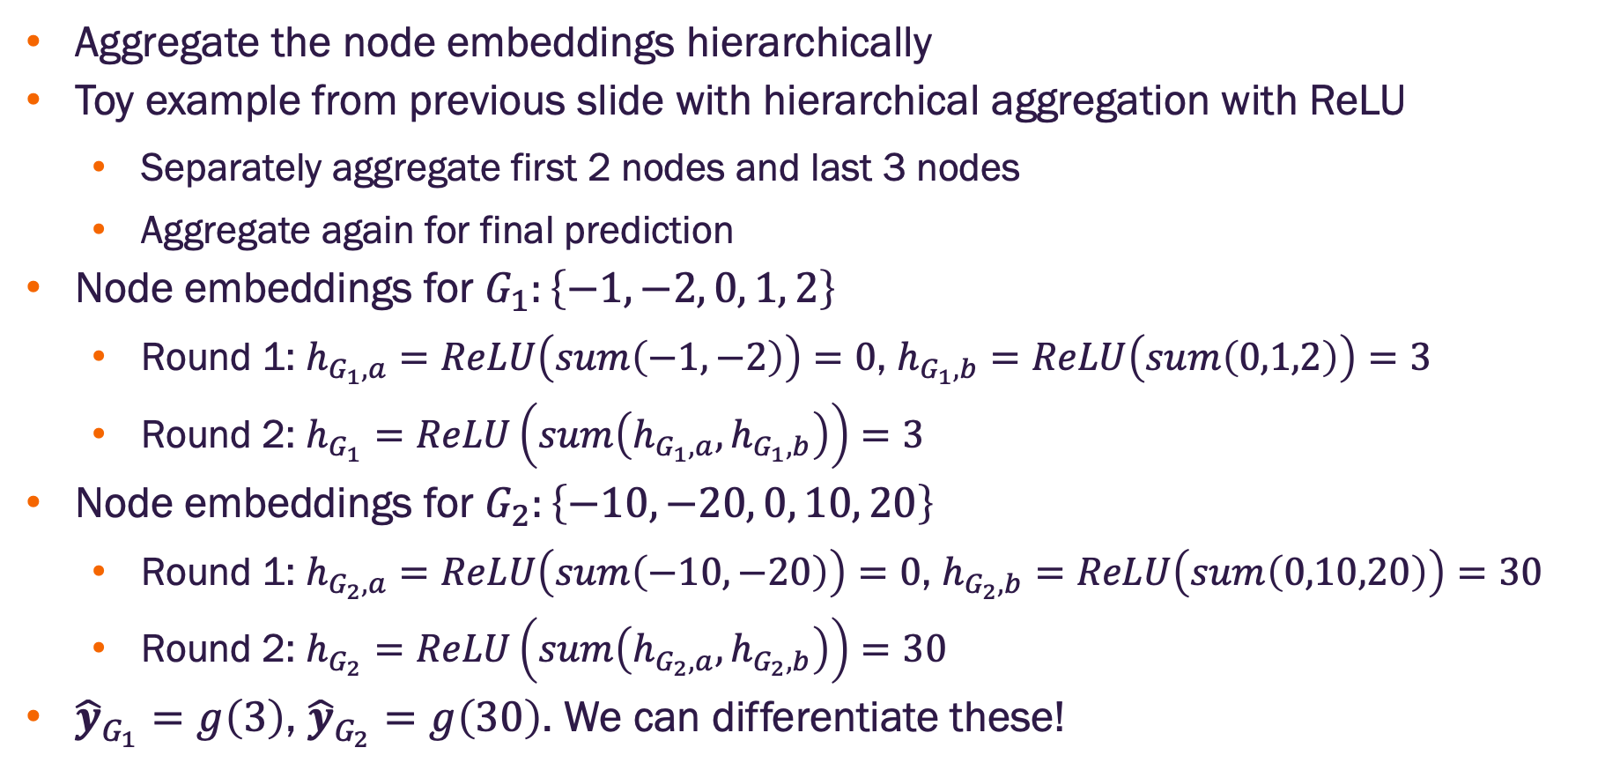
Hierarchical global pooling
Aggregate the node embeddings hierarchically
Toy example from previous slide with hierarchical aggregation with ReLU
Separately aggregate first 2 nodes and last 3 nodes
Aggregate again for final prediction
Node embeddings for $G_{1}:\left\{−1, −2, 0, 1, 2\right\}$
Round 1: $h_{G_{1},a}=ReLU\left(sum\left(−1,−2\right)\right)=0$, $h_{G_{1},b}=ReLU\left(sum\left(0,1,2\right)\right)=3$
Round 2: $h_{G_{1}}=ReLU\left(sum\left(h_{G_{1},a},h_{G_{1},b}\right)\right)=3$
Node embeddings for $G_{2}:\left\{−10, −20, 0, 10, 20\right\}$
Round 1: $h_{G_{2},a}=ReLU\left(sum\left(−10,−20\right)\right)=0$, $h_{G_{2},b}=ReLU\left(sum\left(0,10,20\right)\right)=30$
Round 2: $h_{G_{2}}=ReLU\left(sum\left(h_{G_{2},a},h_{G_{2},b}\right)\right)=30$
${\hat{y}}_{G_{1}}=g\left(3\right)$, ${\hat{y}}_{G_{2}}=g\left(30\right)$. We can differentiate these!

Slide 23
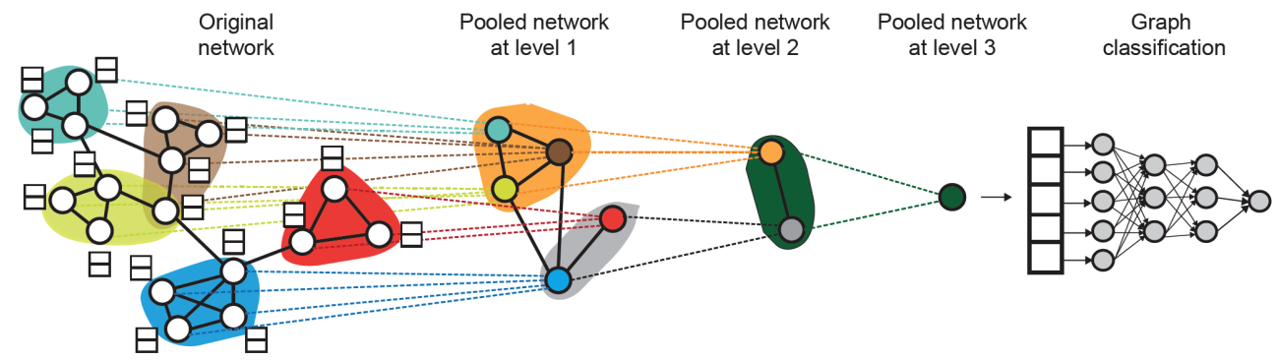
Differentiable pooling
Idea: learn a hierarchical node pooling
Leverage 2 independent GNNs at each pooling level
GNN 1 computes node embeddings
GNN 2 computes node cluster membership
GNN 1 and 2 at each level can be executed in parallel
Image credit: Ying et. al. 2019

Slide 24
Differentiable pooling
Idea: learn a hierarchical node pooling
For each pooling layer
Use cluster assignments to aggregate node embeddings
Create a single new node for each cluster, maintaining edges between clusters to generate next level pooled network
Jointly train GNN 1 and GNN 2
Image credit: Ying et. al. 2019

Slide 25
GNN training

Slide 26
Where do ground-truth labels come from?
Image credit: Jure Leskovec, http://cs224w.stanford.edu

Slide 27
Supervised learning
Supervised learning – labels come from an external source
Examples
Node labels: article topic in a citation network
Edge labels: fraudulent transaction in a financial transaction network
Graph labels: toxicity of a drug

Slide 28
Unsupervised learning
Unsupervised learning – labels come from the graph structure
Examples
Node labels: node statistics such as a centrality measure
Edge labels: link prediction based on input graph structure
Graph labels: graph statistics such as diameter, isomorphism (pair of graphs)
Technically, we have supervision in unsupervised
Unsupervised is more appropriately called self-supervised

Slide 29
How do we compute the final loss?
Image credit: Jure Leskovec, http://cs224w.stanford.edu

Slide 30
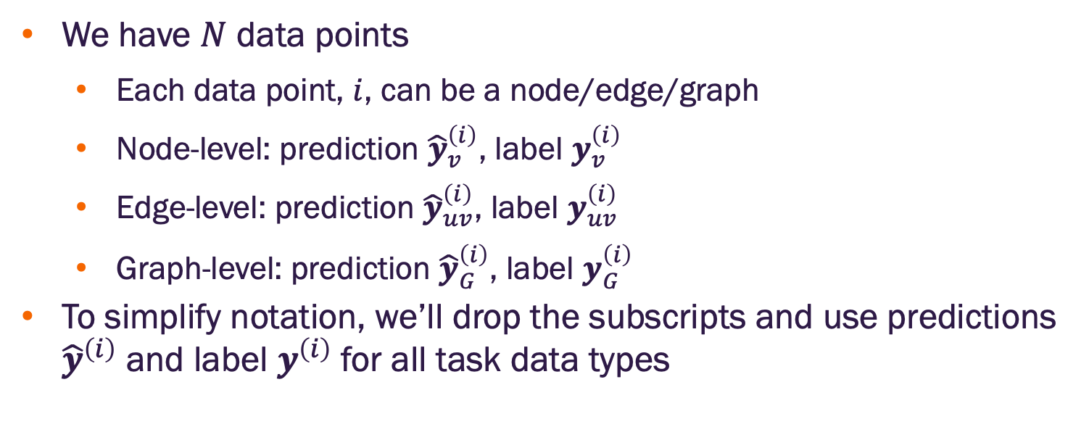
GNN training setting
We have $N$ data points
Each data point, $i$, can be a node/edge/graph
Node-level: prediction ${\hat{y}}_{v}^{\left(i\right)}$, label $y_{v}^{\left(i\right)}$
Edge-level: prediction ${\hat{y}}_{uv}^{\left(i\right)}$, label $y_{uv}^{\left(i\right)}$
Graph-level: prediction ${\hat{y}}_{G}^{\left(i\right)}$, label $y_{G}^{\left(i\right)}$
To simplify notation, we’ll drop the subscripts and use predictions ${\hat{y}}^{\left(i\right)}$ and label $y^{\left(i\right)}$ for all task data types

Slide 31
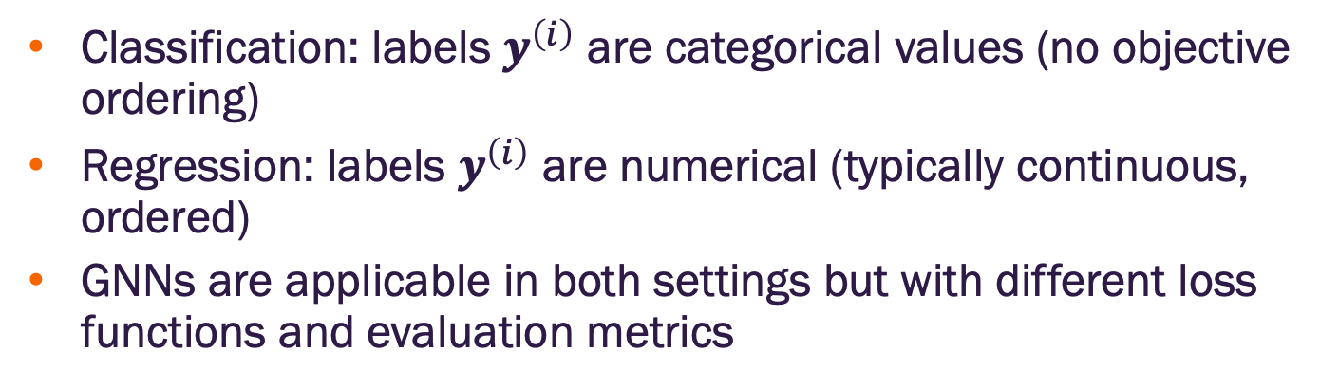
Classification or regression
Classification: labels $y^{\left(i\right)}$ are categorical values (no objective ordering)
Regression: labels $y^{\left(i\right)}$ are numerical (typically continuous, ordered)
GNNs are applicable in both settings but with different loss functions and evaluation metrics

Slide 32
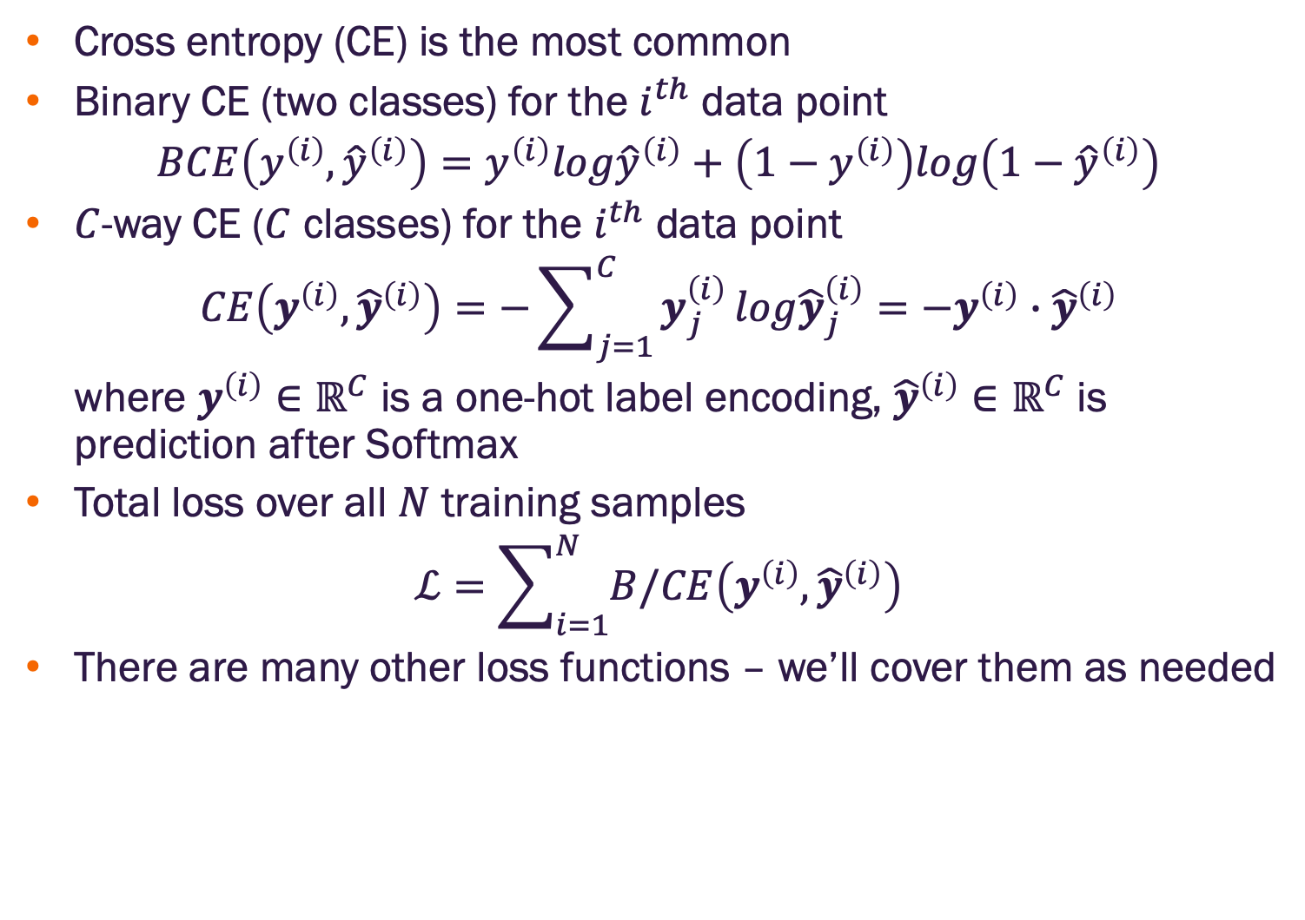
Classification loss functions
Cross entropy (CE) is the most common
Binary CE (two classes) for the $i^{th}$ data point
$$BCE\left(y^{\left(i\right)},{\hat{y}}^{\left(i\right)}\right)=y^{\left(i\right)}log{\hat{y}}^{\left(i\right)}+\left(1−y^{\left(i\right)}\right)log\left(1−{\hat{y}}^{\left(i\right)}\right)$$
$C$-way CE ($C$ classes) for the $i^{th}$ data point
$$CE\left(y^{\left(i\right)},{\hat{y}}^{\left(i\right)}\right)=−\sum_{j=1}^{C}{y_{j}^{\left(i\right)}}log{\hat{y}}_{j}^{\left(i\right)}=−y^{\left(i\right)}∙{\hat{y}}^{\left(i\right)}$$
where $y^{\left(i\right)}∈ℝ^{C}$ is a one-hot label encoding, ${\hat{y}}^{\left(i\right)}∈ℝ^{C}$ is prediction after Softmax
Total loss over all $N$ training samples
$$ℒ=\sum_{i=1}^{N}{B/CE\left(y^{\left(i\right)},{\hat{y}}^{\left(i\right)}\right)}$$
There are many other loss functions – we’ll cover them as needed

Slide 33

Regression loss function
Most often use Mean Squared Error (MSE)
$C$-way MSE ($C$ outcome variables) for the $i^{th}$ data point
$$MSE\left(y^{\left(i\right)},{\hat{y}}^{\left(i\right)}\right)=−\sum_{j=1}^{C}{{\left(y_{j}^{\left(i\right)}−{\hat{y}}_{j}^{\left(i\right)}\right)}^{2}}$$
where $y^{\left(i\right)}∈ℝ^{C}$ is a real valued vector of target outcomes, ${\hat{y}}^{\left(i\right)}∈ℝ^{C}$ is a real valued vector of predicted outcomes
Total loss over all $N$ training samples
$$ℒ=\sum_{i=1}^{N}{MSE\left(y^{\left(i\right)},{\hat{y}}^{\left(i\right)}\right)}$$

Slide 34
GNN performance evaluation

Slide 35
How do we measure performance?
Image credit: Jure Leskovec, http://cs224w.stanford.edu

Slide 36

Evaluation metrics for regression
Use standard machine learning evaluation metrics
Assume we make predictions for $M$ data points
Root mean square error (RMSE)
$$\sqrt{\frac{1}{M}\sum_{i=1}^{M}{{\left(y^{\left(i\right)}−{\hat{y}}^{\left(i\right)}\right)}^{2}}}$$
Mean absolute error
$$\frac{1}{N}\left|y^{\left(i\right)}−{\hat{y}}^{\left(i\right)}\right|$$
Note, for $C$-way regression, these result in a vector – one entry for each target outcome

Slide 37


Classifier error types
All classifier performance metrics are derived from counts of TP, FP, TN, FN
Actual Class
Positive
Negative
True Positive (TP)
False Positive (FP)
False Alarm
Type I Error
Positive
Predicted Class
False Negative (FN)
Type II Error
True Negative (TN)
Negative

Slide 38

Confusion Matrix
We can identify how correctly classified were the observations by computing a Confusion Matrix that shows the correct and misclassified observations.

Slide 39
Classifier performance point metrics
Accuracy = (TP+TN)/(TP+TN+FP+FN)​
Sensitivity (a.k.a Recall, True Positive Rate) = TP/(TP+FN)​ = TP/P
The fraction of actually positive samples predicted positive by the model
Specificity (a.k.a. True Negative Rate) = TN/(TN+FP)​ = TN/N
The fraction of actually negative samples predicted negative by the model
Precision (a.k.a. Positive Predictive Value) = TP/(TP+FP)​
The fraction of samples predicted positive by the model that are actually positive
False Positive Rate (a.k.a. Probability of false alarm) = FP/(FP+TN) = FP/N
F1 Score = 2(Precision*Recall)/(Precision + Recall)​
Balanced Accuracy = (Sensitivity + Specificity)/2​

Slide 40




Classifier performance with ROC and AUC
Recall, we can select $0<γ<1$ as a threshold s.t. $\hat{P}(Y=1)≥γ$ implies $\hat{y}=1$. What happens if we change $γ$?
Receiver Operating Characteristic Curve (ROC)
Illustrates tradeoff between FPR and TPR of a binary classifier as the discrimination threshold, $γ$, is adjusted
Axes
1 – Specificity (false positive rate) = 1 – TN/N
Sensitivity (true positive rate) = TP/P
Area under the curve (AUC)
Summary statistic
AUC = 0.5 indicates no predictive value (random guessing)
AUC = 1.0 indicates perfect predictive value
$$γ$$

Slide 41


Classifier performance with precision-recall curve
Illustrates tradeoff between precision (PPV) and sensitivity of a binary classifier as the discrimination threshold, $γ$, is adjusted
Particularly useful for highly imbalanced datasets (i.e., where one class is very rare). In those cases, it’s possible to achieve high AUC with very low precision*
Axes
Sensitivity (true positive rate) = TP/P
Precision (PPV) = TP/(TP+FP)
Average precision – summary metric indicating the weighted average precision for each discrimination threshold
*Romero-Brufau S, Huddleston JM, Escobar GJ, Liebow M. Why the C-statistic is not informative to evaluate early warning scores and what metrics to use. Crit Care. 2015 Aug 13;19(1):285

Slide 42
Splitting our dataset

Slide 43
Dataset splits
Assume we’re working with a large dataset and not using cross-validation
Randomly split the data into:
Training set: used for optimizing GNN and prediction head parameters
Validation set: used to develop model (different architectures) and tune hyperparameters
Test set: held out until model(s) are finalized to report final performance
If feasible, we should repeat the process and report average performance over many different random splits
Concern: Can we guarantee that the test set is really held out?

Slide 44

Graph data splitting is special
Suppose we are splitting an image dataset for image classification
Each data point is an image
Data points are independent
Image 5 will not affect our prediction for image 1
Image credit: Jure Leskovec, http://cs224w.stanford.edu

Slide 45

Graph data splitting is special
Assume we wish to perform node classification
Each data point is a node
Data points are NOT independent
Node 5 will affect our prediction for node 1 because it will participate in message passing that will affect node 1’s embedding

Slide 46
Transductive setting data splits
The input graph is observed in all data splits (train, validation, test)
Only the node labels are split
Training time, compute embeddings using the entire graph via message passing, evaluate the prediction head performance and update the model parameters using training nodes (1 & 2 in example)
Validation time, compute embeddings using the entire graph and evaluate the prediction head performance on validation nodes (3 & 4 in example)
Image credit: Jure Leskovec, http://cs224w.stanford.edu

Slide 47

Inductive setting data splits
Break edges between the splits (generates multiple graphs / components)
Now we have three independent graphs
Training time, compute embeddings using only the training graph, evaluate the prediction head performance and update model parameters using training nodes (1 & 2 in example)
Validation time, compute embeddings for the validation nodes and evaluate performance on validation nodes (3 & 4 in example)
Image credit: Jure Leskovec, http://cs224w.stanford.edu

Slide 48


Node classification
Transductive – all splits can observe the entire graph structure, but can only observe the labels of their respective nodes
Inductive – each split contains an independent graph
Image credit: Jure Leskovec, http://cs224w.stanford.edu

Slide 49

Graph classification
Only the inductive setting is applicable because we must test on unseen graphs
Image credit: Jure Leskovec, http://cs224w.stanford.edu

Slide 50

Edge (link) prediction
Goal is to predict missing edges
We need to hide some edges in the input graph from the GNN and let the GNN + prediction head determine if the edge should exist
Image credit: Jure Leskovec, http://cs224w.stanford.edu

Slide 51

Setting up edge prediction
We will need to split the edges twice
First split: assign 2 types of edges in the input graph
Message edges: will be used for GNN message passing
Supervision edges: will be used for training and evaluation
After the first split:
Only message edges will remain in the input graph
Supervision edges are not fed into the GNN
Image credit: Jure Leskovec, http://cs224w.stanford.edu

Slide 52

Setting up edge prediction
Option 1: Inductive second split: assign each message & supervision edge to one of train / validation / test
The assigned edges will form three independent graphs
Each graph will have message and supervision edges
Image credit: Jure Leskovec, http://cs224w.stanford.edu

Slide 53

Setting up edge prediction
Option 2: Transductive second split (most common choice)
All message edges used in training, supervision edges split among train / val / test
Image credit: Jure Leskovec, http://cs224w.stanford.edu
Notes:
Why do we use a growing number of edges? After training, supervision edges are known to GNN. Therefore, an ideal model should use supervision edges in message passing at validation time. The same applies to the test time.

Slide 54

Setting up edge prediction
Option 2: Transductive second split (most common choice)
Link prediction settings are tricky. You may see variations in papers.
Image credit: Jure Leskovec, http://cs224w.stanford.edu

Slide 55


